Slide 1
Cross Validation

Slide 2
Cross validation
Cross-validation in machine learning is a technique used to assess how well a model generalizes to unseen data. It helps prevent overfitting and provides a more reliable estimate of a model's performance by evaluating it on multiple subsets of the data.

Slide 3
Types of cross-validation
K-fold cross-validation
Hold-out cross-validation
Stratified k-fold cross-validation
Leave-p-out cross-validation
Leave-one-out cross-validation
Monte Carlo (shuffle-split)
Time series (rolling cross-validation)

Slide 4
K-fold cross-validation
In this technique, the whole dataset is partitioned in k parts of equal size and each partition is called a fold. It’s known as k-fold since there are k parts where k can be any integer - 3,4,5, etc.
One fold is used for validation and other K-1 folds are used for training the model. To use every fold as a validation set and other left-outs as a training set, this technique is repeated k times until each fold is used once.

Slide 5
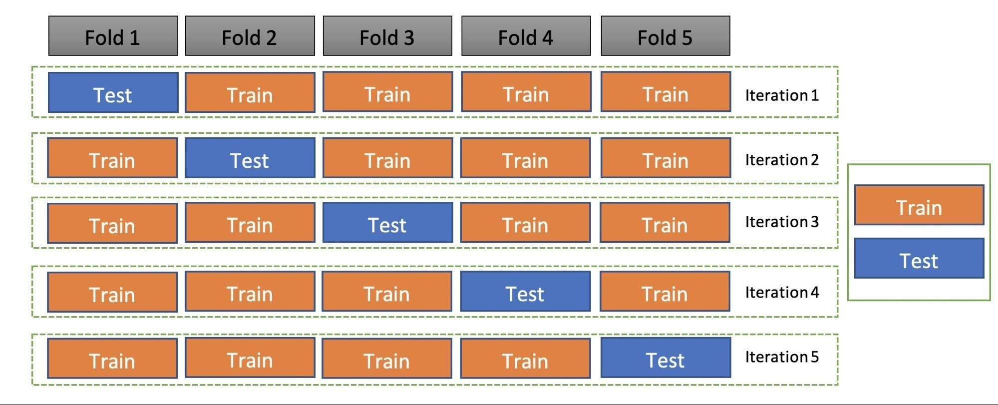

Slide 6
Holdout cross-validation
Also called a train-test split, holdout cross-validation has the entire dataset partitioned randomly into a training set and a validation set. A rule of thumb to partition data is that nearly 70% of the whole dataset will be used as a training set and the remaining 30% will be used as a validation set. Since the dataset is split into only two sets, the model is built just one time on the training set and executed faster.

Slide 7
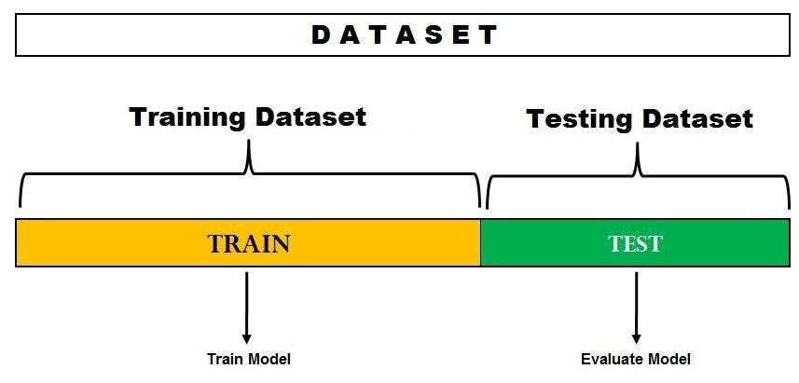

Slide 8
Stratified k-fold cross-validation
As seen above, k-fold validation can’t be used for imbalanced datasets because data is split into k-folds with a uniform probability distribution. Not so with stratified k-fold, which is an enhanced version of the k-fold cross-validation technique. Although it too splits the dataset into k equal folds, each fold has the same ratio of instances of target variables that are in the complete dataset. This enables it to work perfectly for imbalanced datasets, but not for time-series data.

Slide 9
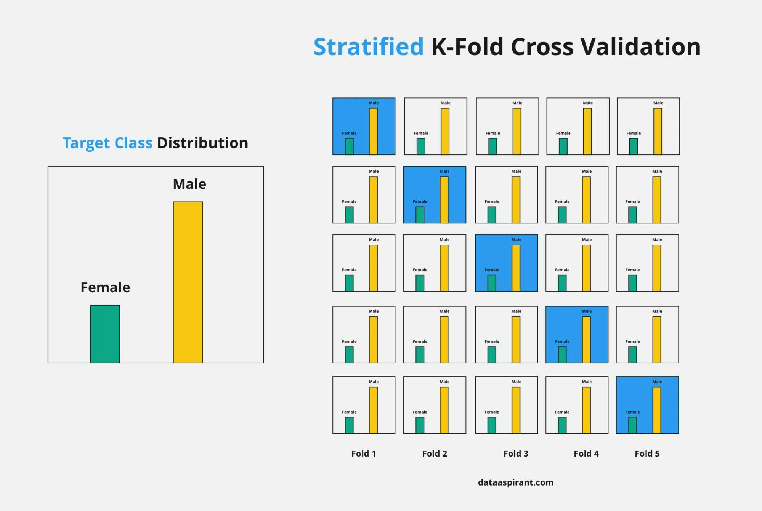

Slide 10
Leave-p-out cross-validation
An exhaustive cross-validation technique, p samples are used as the validation set and n-p samples are used as the training set if a dataset has n samples. The process is repeated until the entire dataset containing n samples gets divided on the validation set of p samples and the training set of n-p samples. This continues till all samples are used as a validation set.
The technique, which has a high computation time, produces good results. However, it’s not considered ideal for an imbalanced dataset and is deemed to be a computationally unfeasible method. This is because if the training set has all samples of one class, the model will not be able to properly generalize and will become biased to either of the classes.

Slide 11
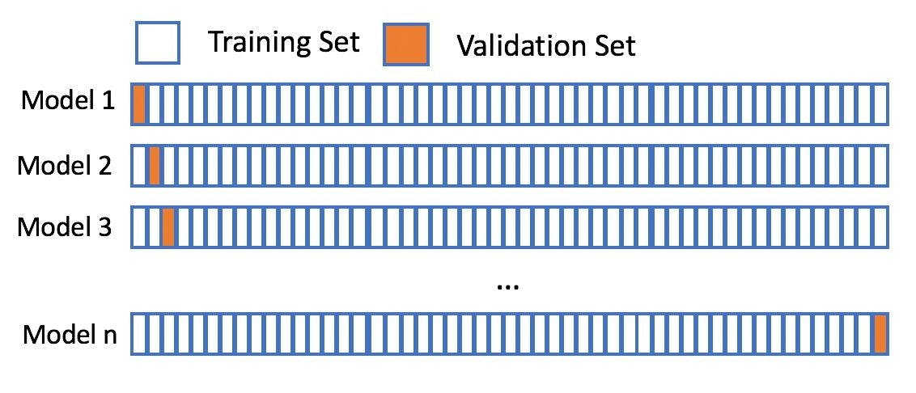

Slide 12
Monte Carlo cross-validation
Also known as shuffle split cross-validation and repeated random subsampling cross-validation, the Monte Carlo technique involves splitting the whole data into training data and test data. Splitting can be done in the percentage of 70-30% or 60-40% - or anything you prefer. The only condition for each iteration is to keep the train-test split percentage different.

Slide 13
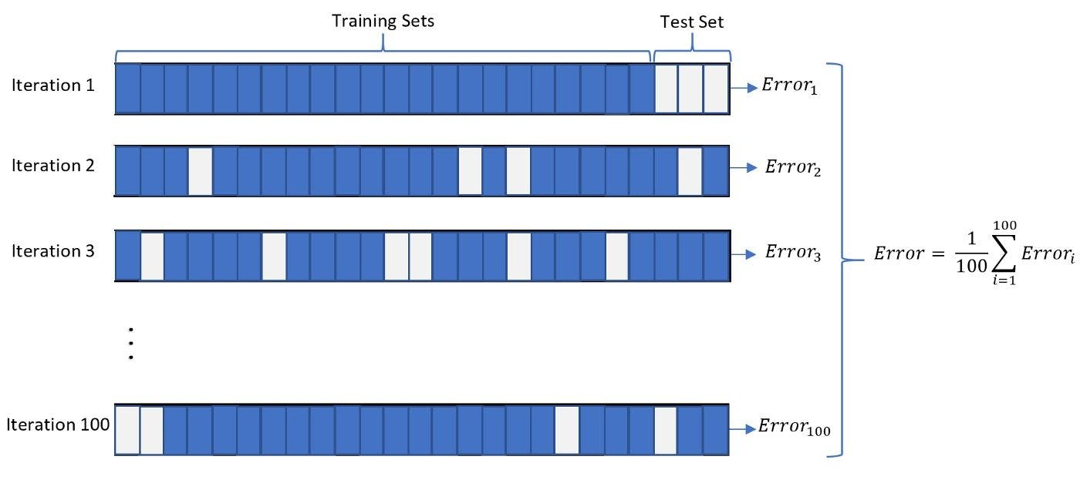

Slide 14
Time series (rolling cross-validation / forward chaining method)
Before going into the details of the rolling cross-validation technique, it’s important to understand what time-series data is.
Time series is the type of data collected at different points in time. This kind of data allows one to understand what factors influence certain variables from period to period. Some examples of time series data are weather records, economic indicators, etc.
In the case of time series datasets, the cross-validation is not that trivial. You can’t choose data instances randomly and assign them the test set or the train set. Hence, this technique is used to perform cross-validation on time series data with time as the important factor.
Since the order of data is very important for time series-related problems, the dataset is split into training and validation sets according to time. Therefore, it’s also called the forward chaining method or rolling cross-validation.
To begin: Start the training with a small subset of data. Perform forecasting for the later data points and check their accuracy. The forecasted data points are then included as part of the next training dataset and the next data points are forecasted. The process goes on.
The image below shows the method.

Slide 15
